Slide 1


Spring Update
June 5th 5:30 –6:45 PM
June 6th 12:00 – 1:15 PM
NH's work under EPA Climate Pollution Reduction Grant (CPRG)

Slide 2


Welcome – Thank you for being here!
New Hampshire Listens is working on behalf of the NH Department of Environmental Services (NHDES) to design and facilitate community engagement—an essential component of NHDES' work under the Climate Pollution Reduction Grant from EPA.
We are here today to update you and hear your questions!

Slide 3




A FEW REMINDERS…
We have formatted today to share updates and gather your questions.
Our time will move quickly.
Mute in large group. We will not have small groups today.
Note to media.
Use chat for responses and resources
Message Courtney - NH Listens for tech assistance
Group Agreements:
Listen to others and share air time.
Participate and be as fully present as you can.
Respect each other and our brief time together.

Slide 4
Today’s Agenda:
Grounding: Brief overview and timeline
Activity: Mentimeter to collect info and gather your questions
Spotlight: Update on PCAP and Implementation grant applications
Spotlight: What's next and CCAP
Q & A Session with NH DES
Your input: Continued engagement
Close: right after the hour (65 min.)
Optional: Stay on for an additional 10 min of questions

Slide 5
Activity: Mentimeter
Getting a sense of who’s on the zoom
What sector(s) do you work in? (you can choose more than one)
  Buildings
  Industry
  Natural & Working Lands
  Power
  Waste
  Equitable Outcomes and Stakeholder Engagement
  Workforce Development
  Coalitions (example: rail trail coalitions)
Did you attend any of the fall / winter CPRG community engagement sessions either online or in person? Yes / No

Slide 6
Climate Pollution Reduction Grants (CPRG)
U.S. EPA funding to help NHDES draft Climate Action Plans and implement greenhouse gas (GHG) reduction measures
Planning Grant (4 Years)
August 15, 2023 - NHDES received a planning grant to work on Climate Action Plans
March 1, 2024 - NHDES submitted Priority Climate Action Plan (PCAP)
August 2025 - NHDES to submit Comprehensive Climate Action Plan (CCAP)
August 2027 - NHDES to submit a Comprehensive Status Report
Implementation Grant (5 Years)
April 1, 2024 - NHDES submitted Implementation Grant application to fund measures in the PCAP
July 2024 – EPA will announce awards
October 2024 – EPA will award funds
October 2029 - NHDES to submit Final Report on Implementation Grant achievements
Notes:
Two grants:
– two timelines with different milestones, lengths, and deliverables
– one team working on both.

Slide 7

The Core NHDES CPRG team
(contact us at: cprg@des.nh.gov)
Jennifer Galbraith, Climate and Energy Manager, Technical Services Bureau, Air Resources Division
James Tilley, Climate Planning Manager, Technical Services Bureau, Air Resources Division
Kurt Yuengling, Community Engagement Specialist, Permitting and Environmental Health Bureau, Air Resources Division
Brendan Wyman, Clean Air Act Grant Manager, Technical Services Bureau, Air Resources Division
Depending on Implementation Grant awards, create up to 3 new positions to administer the funds.

Slide 8
The Justice40 Initiative:
“the Federal Government has made it a goal that 40 percent of the overall benefits of certain Federal investments flow to disadvantaged communities that are marginalized, underserved, and overburdened by pollution”
EPA CPRG Planning Grant Objectives
Tackle damaging climate pollution while supporting the creation of good jobs and lowering energy costs for families.
Accelerate work to address environmental injustice and empower community-driven solutions in overburdened neighborhoods.
Deliver cleaner air by reducing harmful air pollution in places where people live, work, play, and go to school.
EPA CPRG Implementation Grant Goals
Implement ambitious measures (identified in PCAP) that will achieve significant reductions by 2030 and beyond;
Pursue measures that will achieve substantial community benefits by reducing air pollutants, particularly in low-income and disadvantaged communities;
Complement other funding sources to maximize GHG reductions and community benefits;
Pursue innovative policies and programs that are replicable and can be “scaled up” across multiple jurisdictions

Slide 9
First Round of Engagement
First Round of Engagement Efforts - we asked stakeholders and the public to:
Focus on emission reduction projects, not policies
Help identify near-term, high-priority, implement ready projects, including:
  potential barriers to implementation of measures that could be addressed with these funds.
  potential partners for implementation of measures and distribution of funds.
  existing funding programs which result in GHG emission reductions.
We reviewed:
Planning Grant Goals and Requirement
Implementation Grant Goals and Requirements
Justice 40 Initiatives
Timeline
Notes:
With all of the goals and requirements under the programs, and the short timeline, we focused PCAP input with the lens of applying for Implementation Grant. Next round of Engagement will be the place for CCAP measures and ideas.

Slide 10
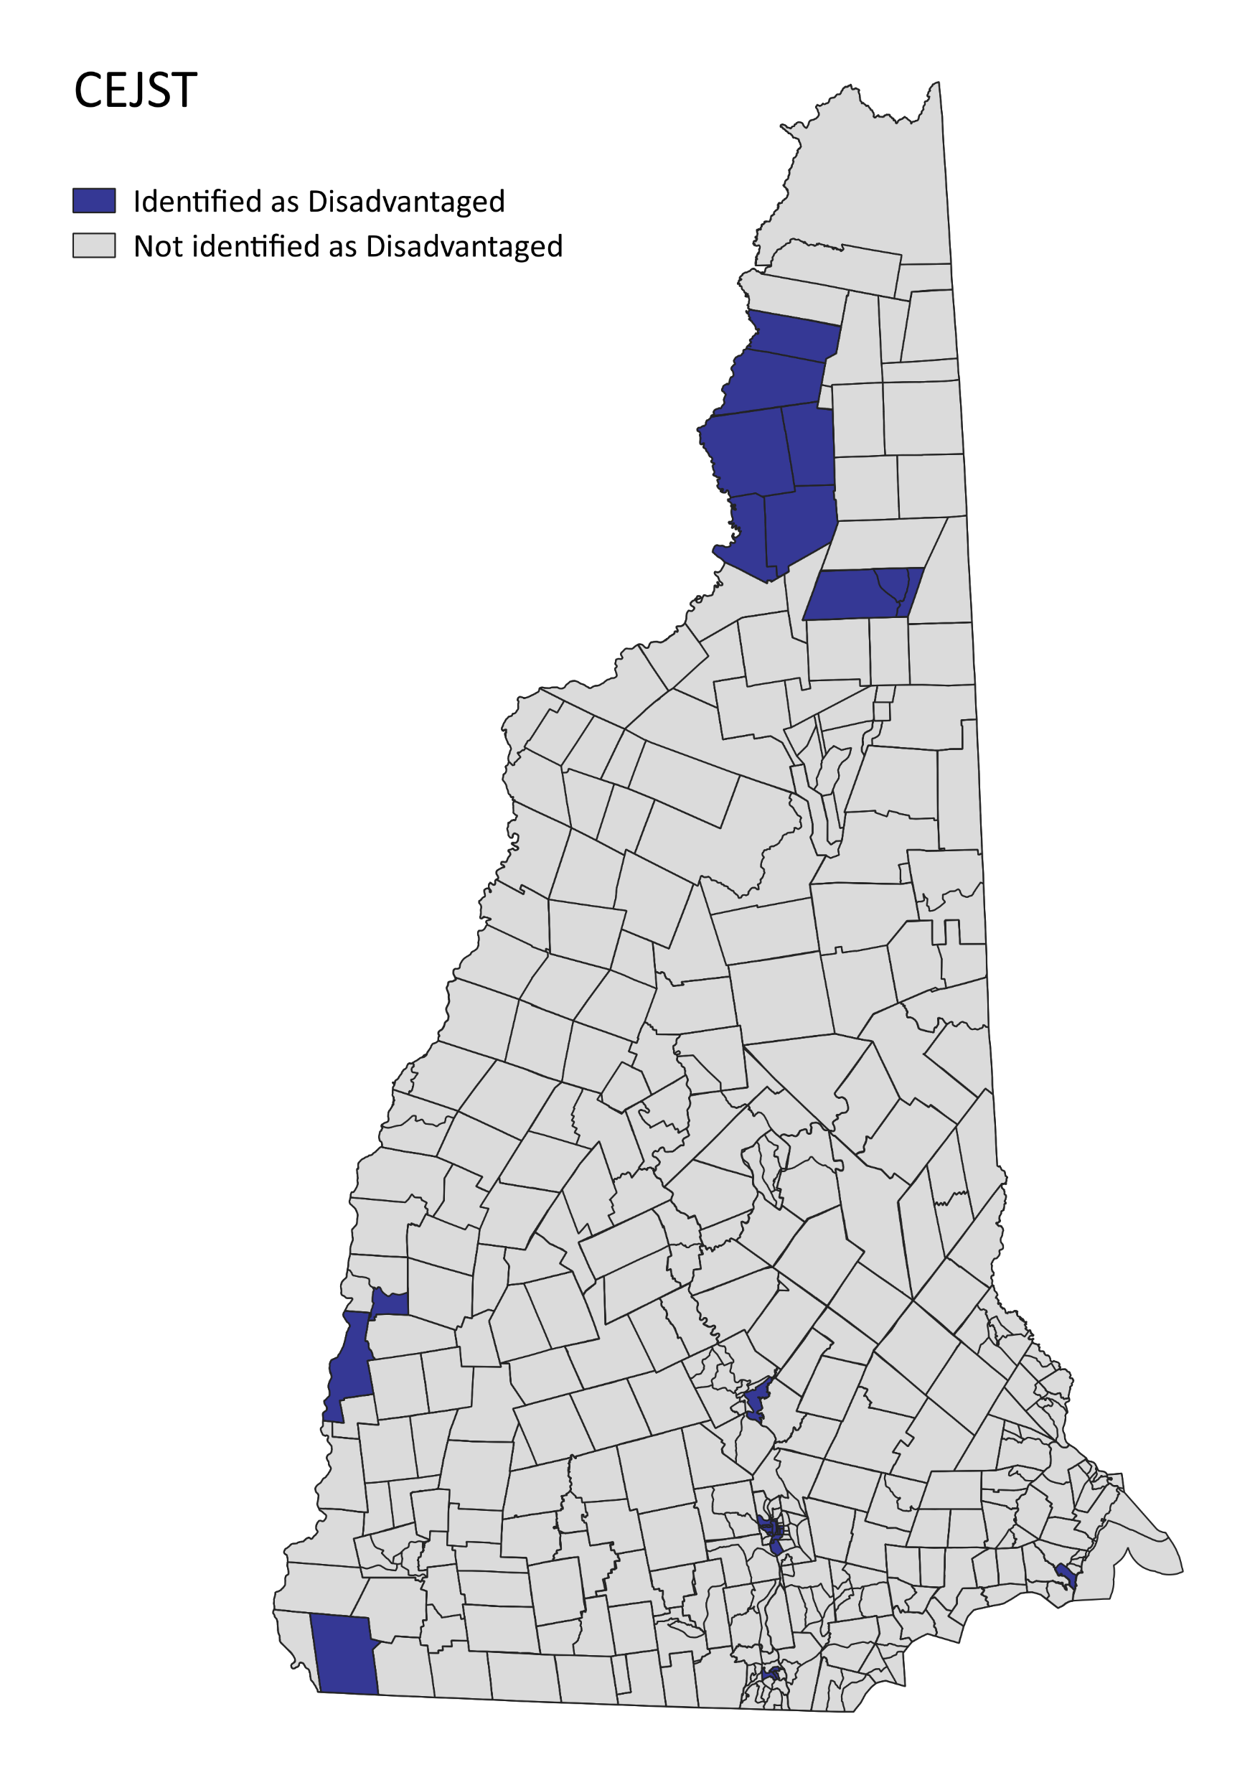
Overview of PCAP Engagement Efforts
NH Listens Interviews
Oct/Nov 2023 - reached out to 36 Stakeholders
NH DES – Designated CPRG Email
Nov 2023 – Feb 2024: 162 emails received and read
NH DES and NH Listens (UNH) – Late 2023/Early 2024
7 In-person Community Engagement Events
3 Statewide Online Community Conversations
3 Statewide Online Cross-Sector Stakeholder Meetings
NH DES CPRG Engagement With NH State Agencies
Dec 2023/Jan 2024: meetings w/ other state agencies
Jan 2024: Dept of Environmental Services – all divisions
NH DES – Public Notice Of Draft Priority PCAP Measures
Feb 5-20, 2024: comment period
North Country / White Mts
Berlin
North Country
Colebrook (canceled)
Greater Connecticut River Valley
Claremont
Greater Capitol Region
Concord
Greater Manchester
Manchester
Greater Seacoast
Hampton
Greater Monadnock
Winchester
Greater Nashua
Nashua
Notes:
Referring back to the previous slides (goals/objectives/requirements), Engagement Efforts were a multipronged approach:
- reaching out to groups already working on Climate and LIDAC Issues
- reaching out to the public to help identify and prioritize GHG reduction measures, potential implementation partners, and potential barriers
- other state agencies with existing programs that may result in reduced GHG emissions
- inviting input via in person events, virtual events, and email.
- targeting LIDAC communities and attempting to engage state-wide

Slide 11
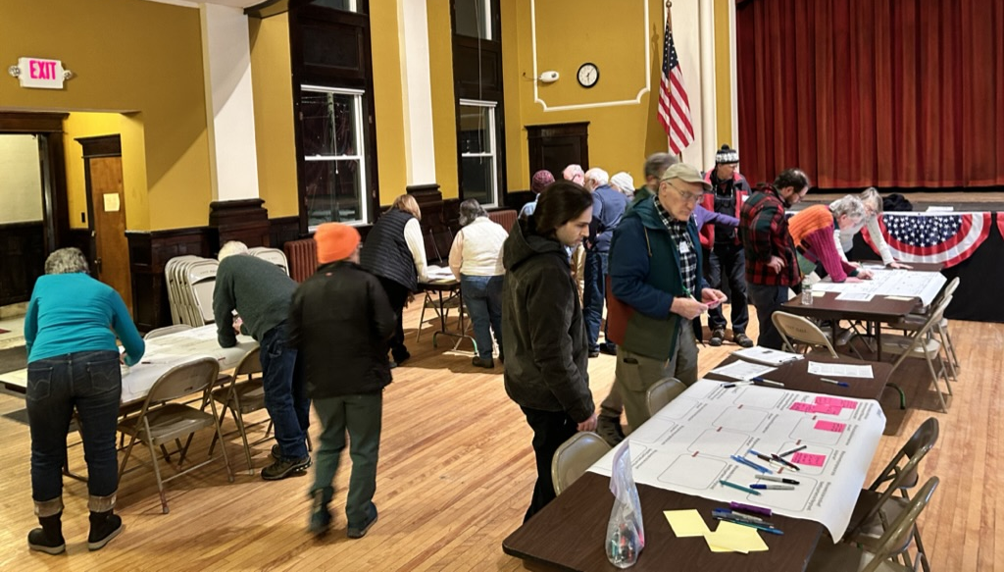
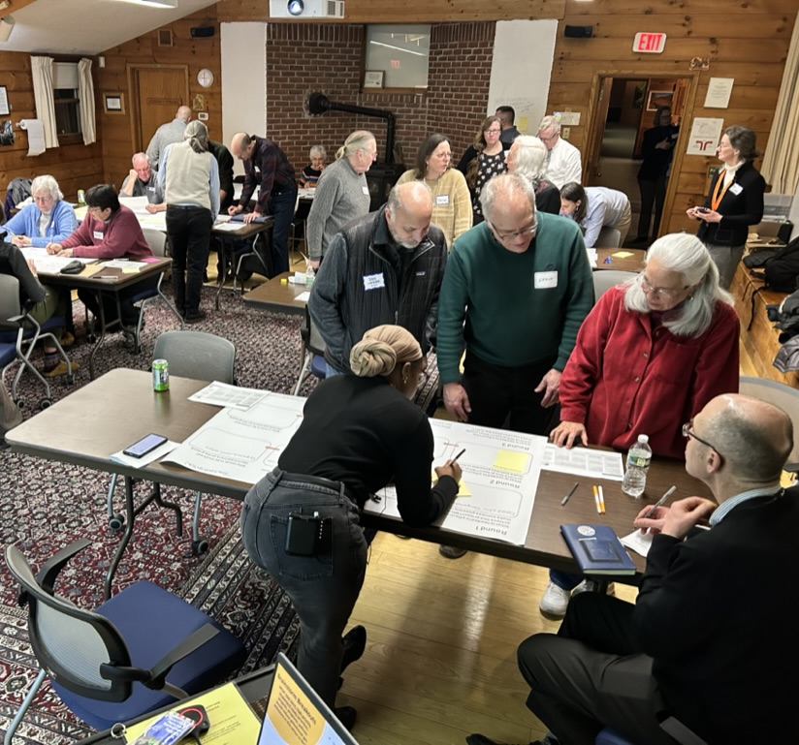
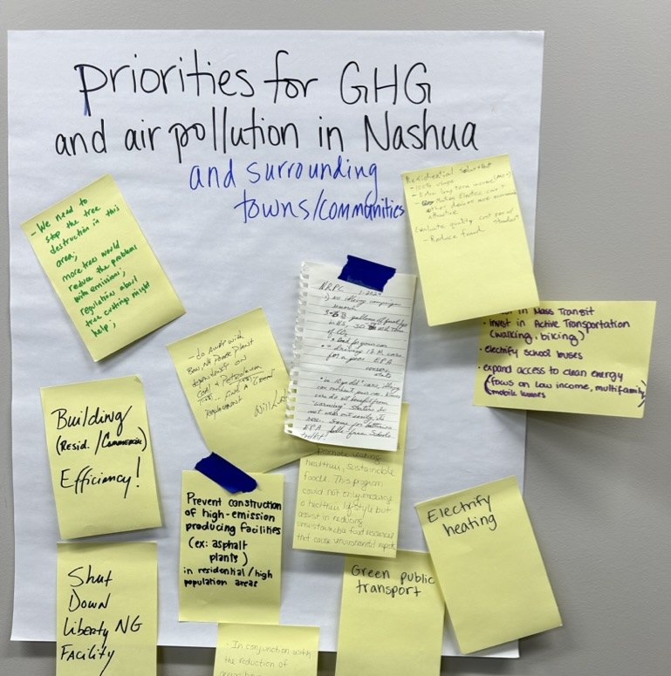
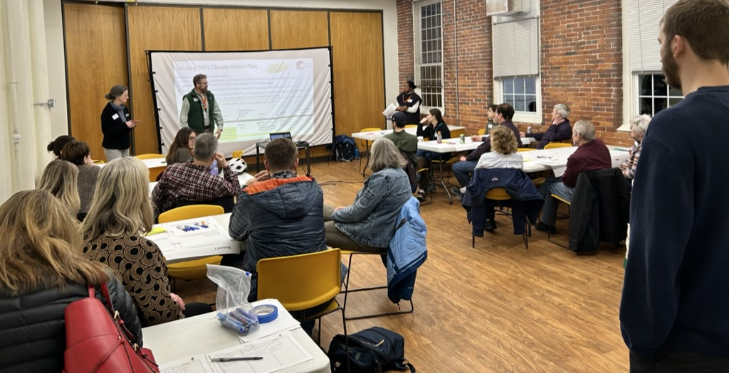
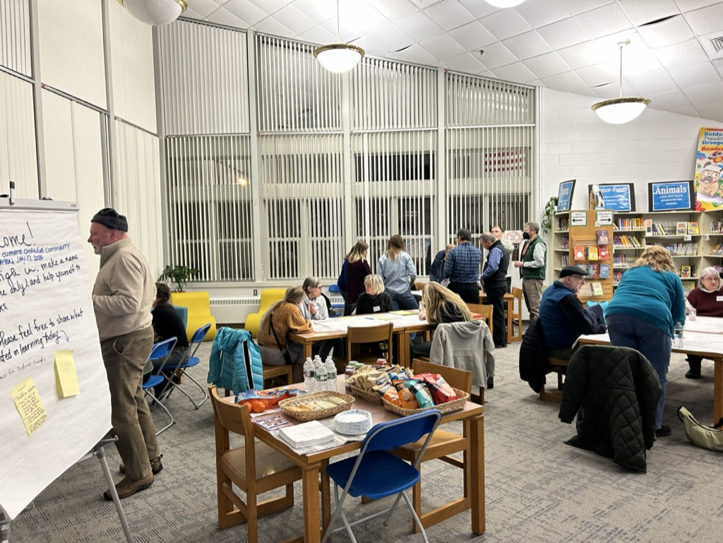
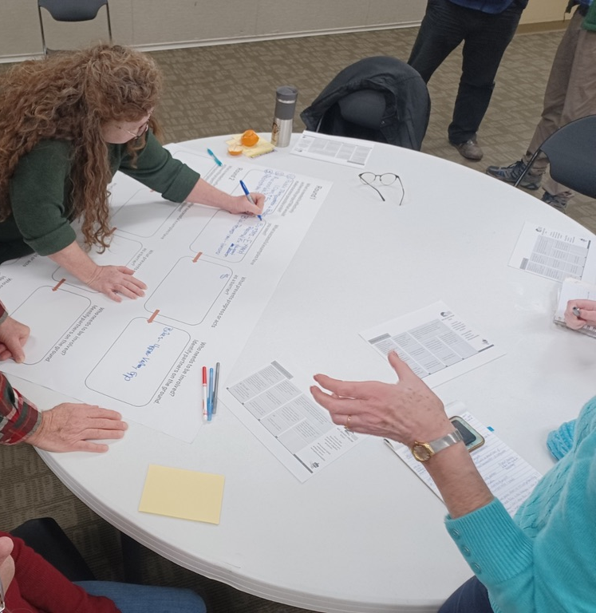
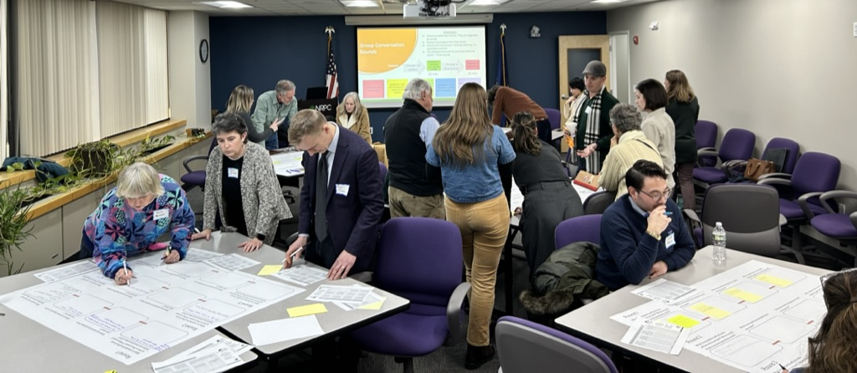
In-Person Community Engagement facilitated by NH Listens
Notes:
Shows the range of venues: City Halls, Schools, Science Centers, Non-Profits, RPC’s
Various methods for collecting input and facilitating collaboration and discussions
As part of our first round of Engagement Efforts we asked stakeholders and the public to:
focus on emission reduction projects, not policies,
help identify near-term, high-priority, implement ready projects, including:
potential barriers to implementation of measures that could be addressed with these funds.
potential partners for implementation of measures and distribution of funds.
existing funding programs which result in GHG emission reductions.

Slide 12
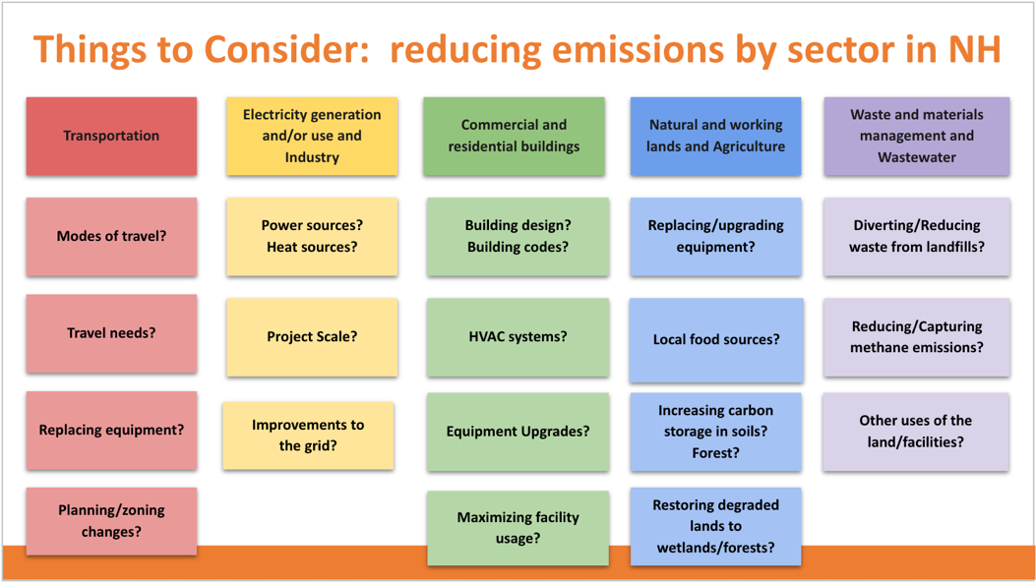
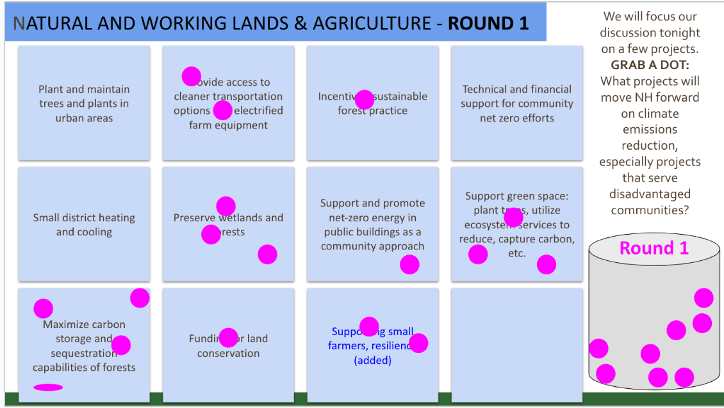
Virtual Community Engagement facilitated by
NH Listens
Notes:
These events went way beyond virtual presentations – breakout rooms and access to google docs allowed participants to write ideas on sticky notes and prioritize the groups brainstorm of possible measures for implementation.

Slide 13
Activity: Zoom Q&A
Collecting your questions:
As we hear the updates:
What questions do you have today about PCAP measures, Implementation Grants, upcoming CCAP and next steps?

Slide 14
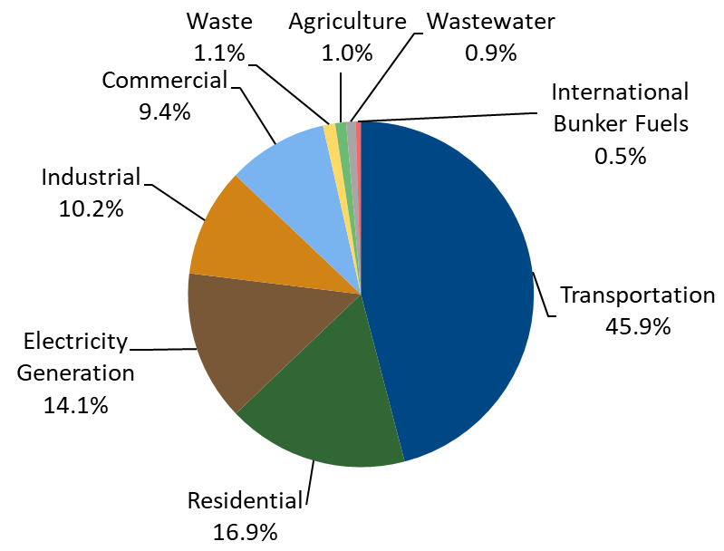
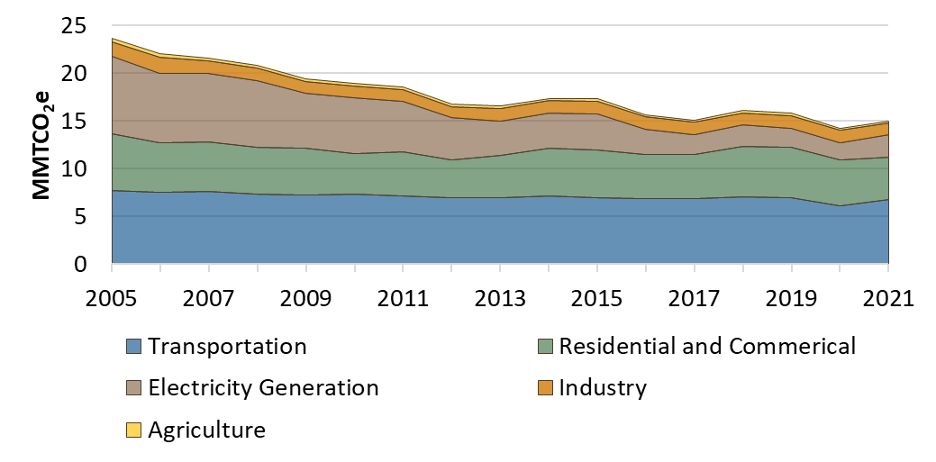
What We're Hearing and Learning
New Hampshire’s GHG Emissions by Economic Sector (%)
NH Emissions - two biggest sectors were Transportation and Buildings.
Reducing NH Emissions – progress lags behind our neighboring states.
Engagement Events – lots of interest in Transportation, Buildings, and Electric Power.
PCAP measures - Transportation and Residential Building Sectors are the highest priority.
One of the main barriers identified to implementing these measures is workforce numbers, making Workforce Development another top priority.
Charts from NH's PCAP
Notes:
Based on the GOG Emissions Inventory data and what we heard at engagement events, the primary measures for the PCAP started to coalesce:
- Transportation and Residential Heating – top two sectors for emissions AND top two areas people focused on at events
- Workforce growth is crucial
MMTCO2e = million metric tons of carbon dioxide equivalents
https://www.des.nh.gov/sites/g/files/ehbemt341/files/documents/state-of-new-hampshire-priority-climate-action-plan.pdf

Slide 15
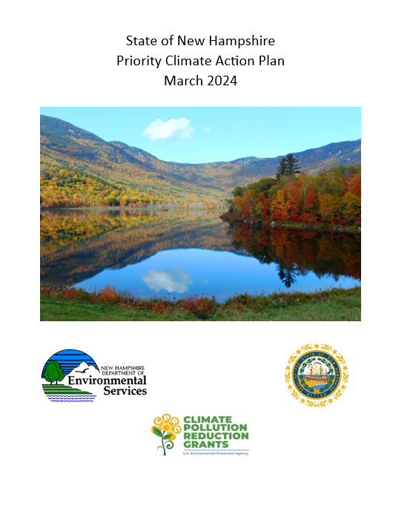
New Hampshire Priority Climate Action Plan
(submitted to EPA & published March 1, 2024)
Chapter 1: CPRG Overview
Chapter 2: NH’s Greenhouse Gas Emissions: Past to Present
Chapter 3: NH’s Greenhouse Gas Inventory
Chapters 4 – 9: Priority Greenhouse Gas Reduction Measures
Chapter 10: Authority to Implement Priority Measures
Chapter 11: Low-Income Disadvantaged Community Benefits Analysis
Chapter 12: Coordination and Outreach
References
Appendices
Notes:
178 pages
GO QUICK !

Slide 16
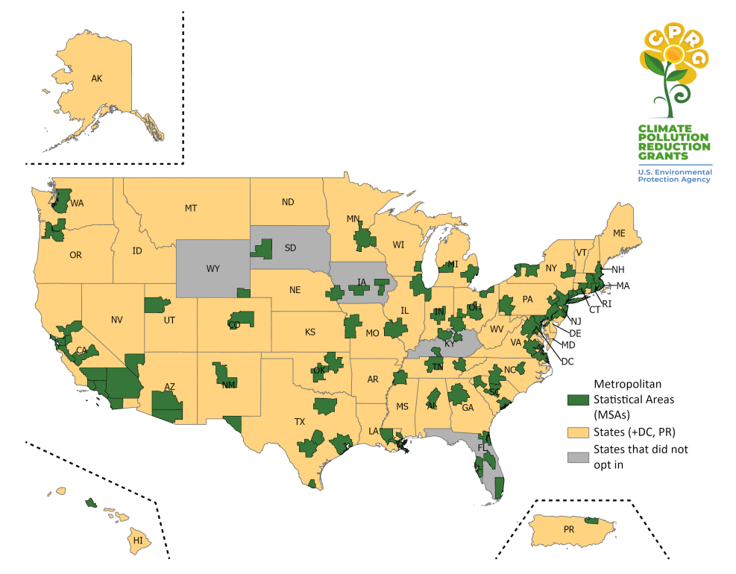
Implementation Grants for Measures in a PCAP
Eligible Applicants Eligible applicants for the CPRG implementation grants competitions are limited to lead organizations for CPRG planning grants and other executive branch-level agencies, offices, and departments in states, D.C., Puerto Rico, municipalities, tribes, tribal consortia, territories, and groups of such entities applying for funding to implement measures contained in one or more applicable Priority Climate Action Plan (PCAP) developed with funding from a CPRG planning grant.
Total Implementation Grant Program Funding = $4.3 billion
U.S. EPA anticipates awarding:
approximately 30 to 115 grants
range $2 to $500 million each
Tier | Implementation Grant Ranges | Funds Targeted | Anticipated Number of Grants to be Awarded
Tier A | $200–500 million | $2 billion | 4-10
Tier B | $100-200 million | $1.3 billion | 6-13
Tier C | $50-100 million | $0.6 billion | 6-12
Tier D | $10-50 million | $0.3 billion | 6-30
Tier E | $2-10 million | $0.1 billion | 10-50
 | Planning Grants Awarded
47 | States (+DC, PR)
79 | Metropolitan Statistical Areas (MSAs)
Map: EPA
Notes:
As we read it, EPA planned to award fewer Implementation Grants than Planning Grants – encouraging coalitions
Traditionally, NH receives around 1% of federal expenditures (such as infrastructure spending) – Tier D for the state application seemed appropriate.
Who could apply?
Anyone who got a Planning Grant (126)
Any agencies/offices/departments/municipality/group established in statute
As we read it, EPA planned to award fewer Implementation Grants than Planning Grants – encouraging coalitions
About CPRG Planning Grant Information | US EPA; https://www.epa.gov/inflation-reduction-act/about-cprg-planning-grant-information
Next slides tie PCAP to these applications and discuss what implementation may look like.

Slide 17
Implementation Grants for PCAP Measures
Total Implementation Grant Program Funding = $4.3 billion
U.S. EPA anticipates awarding:
approximately 30 to 115 grants
range $2 to $500 million each
 | Planning Grants Awarded
47 | States (+DC, PR)
79 | Metropolitan Statistical Areas (MSAs)
Tier | Implementation Grant Ranges | Funds Targeted | Anticipated Number of Grants to be Awarded
Tier A | $200–500 million | $2 billion | 4-10
Tier B | $100-200 million | $1.3 billion | 6-13
Tier C | $50-100 million | $0.6 billion | 6-12
Tier D | $10-50 million | $0.3 billion | 6-30
Tier E | $2-10 million | $0.1 billion | 10-50
New Hampshire State application, Tier D, $49,999,999
New England Heat Pump Accelerator Program Coalition application 5 states, Tier A, $500 million
States Supporting Resilient Local Energy Coalition Program application 15 states, Tier A, $500 million
Map: EPA
Notes:
As we read it, EPA planned to award fewer Implementation Grants than Planning Grants – encouraging coalitions
Traditionally, NH receives around 1% of federal expenditures (such as infrastructure spending) – Tier D for the state application seemed appropriate.
Who could apply?
Anyone who got a Planning Grant (126)
Any agencies/offices/departments/municipality/group established in statute
As we read it, EPA planned to award fewer Implementation Grants than Planning Grants – encouraging coalitions
About CPRG Planning Grant Information | US EPA; https://www.epa.gov/inflation-reduction-act/about-cprg-planning-grant-information
Next slides tie PCAP to these applications and discuss what implementation may look like.

Slide 18
PCAP Measures and Implementation Grant applications
Sector or Area of Work | New Hampshire’s Priority Climate Action Plan (PCAP) Measures | Implementation Grant Applications
Transportation | Electric Charging Infrastructure for Electric Vehicles | New Hampshire State Application ($10 million of the $50 million)
Transportation | Expanded Public Transit Options | New Hampshire State Application ($5 million of the $50 million)
Residential Building | Heat Pumps to Improve Energy Efficiency of Space and Water Heating of Buildings | New England Heat Pump Accelerator Program ($500 million for residents across 5 states)
Residential Building | Weatherization to Improve Energy Efficiency in Residential Buildings | New Hampshire State Application ($15 million of the $50 million)
Residential Building | Pre-Weatherization to Improve Energy Efficiency in Residential Buildings | New Hampshire State Application ($15 million of the $50 million)
Local Government Building and Facility | Resilient Local Energy Systems | States Supporting Resilient Local Energy ($500 million for municipalities across 15 states)
Local Government Building and Facility | Energy Efficiency Improvements at Wastewater & Drinking Water Systems | New Hampshire State Application ($10 million of the $50 million)
Waste and Materials Management | Expand Programs for Waste Reduction, Diversion and Recycling | New Hampshire State Application ($5 million of the $50 million)
Workforce Development | Workforce Development of Skilled Trades to Support Priority Measures | New Hampshire State Application ($5 million of the $50 million)

Slide 19
Next Steps under the Climate Pollution Reduction Grants
Planning Grant work
Drafting the Comprehensive Climate Action Plan (CCAP) due August 2025
Engagement with stakeholders, the public, and other state agencies focused on CCAP components such as:
  GHG emission targets and goals.
  Additional GHG reduction measures by Sector (expanding on the PCAP) including additional projects, programs, and policies that could be implemented.
  Identifying additional funding sources for the measures.
Implementation Grant work
Being prepared to administer funds quickly, efficiently, and effectively.
Engagement with stakeholders, the public, and other state agencies as the funding mechanisms and Requests for Funding Proposals (RFP’s) are drafted and finalized.
This may include steps such as:
  Requests for Funding Information (RFI’s)
  Requests for Funding Qualification (RFQ’s)
  Sessions to identify barriers and challenges facing applicants in past state and federal funding programs.
NHDES has existing authority to receive, administer, and internally audit all present and future federal and state air pollution control grant programs
Notes:
Two grants:
– two timelines with different milestones, lengths, and deliverables
– one team working on both.
- Engagement events will likely be updates, past work (PCAP/I.G.), engagement w.r.t CCAP and Implementation Mechanisms

Slide 20
Preparing for the Comprehensive Climate Action Plan (CCAP)
- Due August 2025
- Building on the PCAP work
Priority Climate Action Plan (PCAP)
Greenhouse Gas (GHG) Inventory
Quantified GHG Reduction Measures
LIDAC Benefits Analysis
Review of Authority to Implement
CCAP Drafting Process:
second round of engagement
workgroups
expanded website
public notices with drafts
Comprehensive Climate Action Plan
Greenhouse Gas (GHG) Inventory
GHG Reduction Targets
GHG Emissions Projections
Quantified GHG Reduction Measures
State-Wide Benefits Analysis
LIDAC Benefits Analysis
Review of Authority to Implement
Workforce Planning Analysis
Plan to Leverage other Federal Funding
Notes:
This slide can be used to discuss the requirements for the CCAP and how it builds on the PCAP.
Additional Engagement with the public and stakeholders will be needed – targeted based on the components of the CCAP.
NEXT – more about federal screening tools

Slide 21
PCAP Measures and Distribution of Implementation Grant Funds
Sector or Area of Work | NH’s PCAP Measures | Implementation Funding Mechanisms
Transportation | Electric Charging Infrastructure for Electric Vehicles | NHDES would issue a competitive RFP to contract with third-party administrator that would develop a rebate or grant program
Transportation | Expanded Public Transit Options | NHDES CPRG team (additional staff) will create and administer competitive subaward process (non-profits and municipalities)
Residential Building | Heat Pumps to Improve Energy Efficiency of Space and Water Heating of Buildings | A regional contractor selected via a competitive procurement process will implement the program
Residential Building | Weatherization to Improve Energy Efficiency in Residential Buildings | NHDES CPRG team (additional staff) will create and administer competitive subaward process (non-profits and municipalities) and competitive subcontract process (for-profit businesses)
Residential Building | Pre-Weatherization to Improve Energy Efficiency in Residential Buildings
Local Government Building and Facility | Resilient Local Energy Systems | Competitive subawards to municipalities implemented by NHDES through a state grant program.
Local Government Building and Facility | Energy Efficiency Improvements at Wastewater & Drinking Water Systems | Competitive subawards to municipalities, administered by NHDES’ Water Infrastructure Energy Efficiency Program
Waste and Materials Management | Expand Programs for Waste Reduction, Diversion and Recycling | Competitive subawards to municipalities implemented through a state grant program, overseen by NHDES’ Solid Waste Management Bureau
Workforce Development | Workforce Development of Skilled Trades to Support Priority Measures | NHDES CPRG team (additional staff) will create and administer competitive state grant program

Slide 22
Core NHDES CPRG team
(contact us at: cprg@des.nh.gov)
Jennifer Galbraith, Climate and Energy Manager, Technical Services Bureau, Air Resources Division
James Tilley, Climate Planning Manager, Technical Services Bureau, Air Resources Division
Kurt Yuengling, Community Engagement Specialist, Permitting and Environmental Health Bureau, Air Resources Division
Brendan Wyman, Clean Air Act Grant Manager, Technical Services Bureau, Air Resources Division
Depending on Implementation Grant awards, create up to 3 new positions to administer the funds.

Slide 23
Q & A Session
Your questions about PCAP measures, Implementation Grants, upcoming CCAP and next steps?

Slide 24
Activity: Continued engagement
ZOOM QUESTIONS
Share your thoughts in survey about opportunities for continued engagement now and for CCAP:
  How do you like to stay engaged with NH’s CPRG process? Multiple choice:
    Online update sessions
    NH DES to come give a presentation at my work / community group / coalition
    In person community conversations and opportunities to connect with other people working on NH’s emissions reduction
    Other?
  Your suggestions:
    What groups to involve if the implementation grants are approved?
    What groups to involve in ongoing CCAP engagement?

Slide 25
Contact our Team
Kurt Yuengling
Community Engagement Specialist
Environmental Health Program, Air Resources Division, NHDES
kurt.r.yuengling@des.nh.gov
Carrie Portrie
Research Assistant Professor and Program Manager
New Hampshire Listens, Carsey School of Public Policy
Carrie.Portrie@unh.edu
Mikayla Townsend
Program Coordinator
New Hampshire Listens, Carsey School of Public Policy
Mikayla.Townsend@unh.edu
Contact NH DES at: cprg@des.nh.gov
INVITE US to YOUR MEETINGS, GROUPS etc.
We are in Year 1 of the Climate Pollution Reduction Grant Planning work.
We can visit your groups as we move toward Implementation Grants and Comprehensive Climate Action Plan.

Slide 26
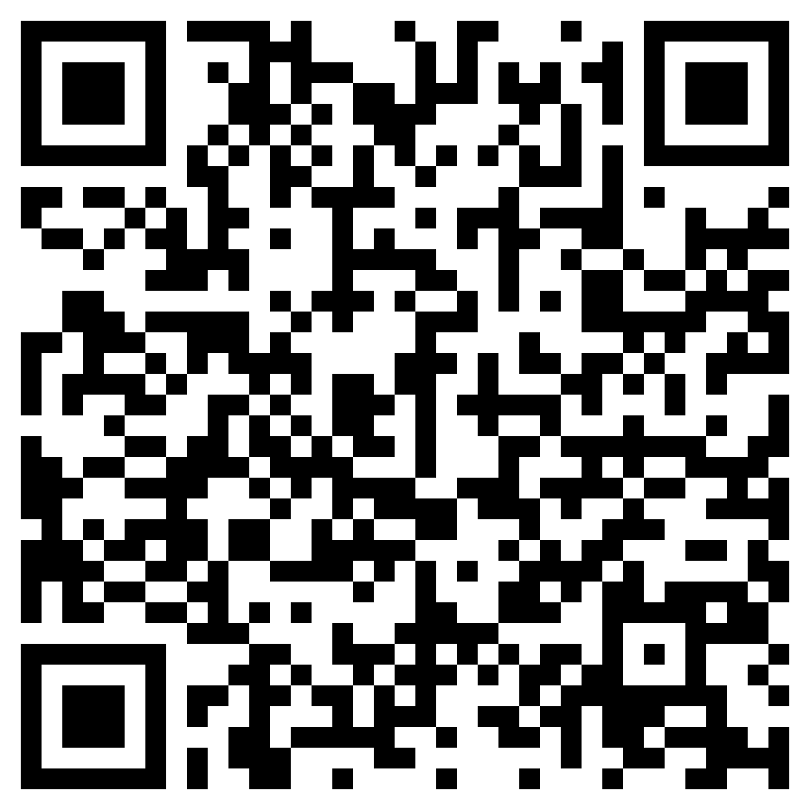
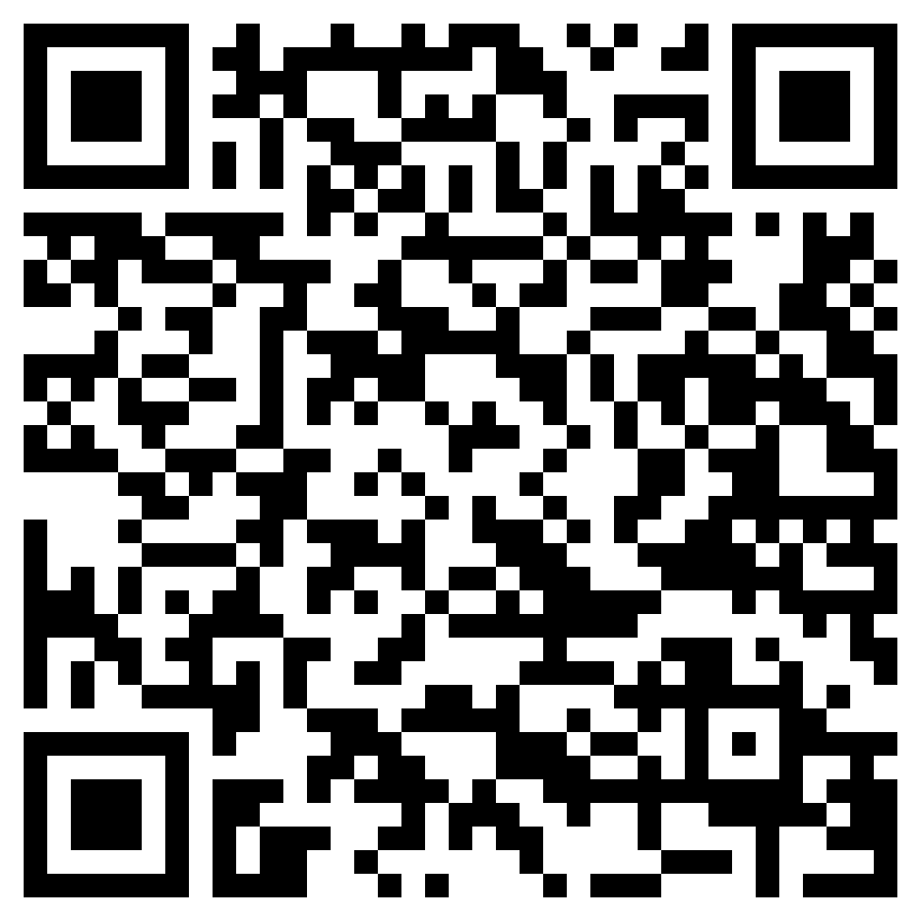
For more information:
NHDES CPRG webpage
UNH NH Listens CPRG webpage
Contact the NHDES CPRG team at:
cprg@des.nh.gov

Slide 27
MORE Q & A
Your questions about PCAP measures, Implementation Grants, upcoming CCAP and next steps?

